Slide 1
Wolverhampton Group 10/05/2017

Slide 2
About IAM RoadSmart About the Group (from Memory)

Slide 3
IMI Local Observer Qualification
211 Groups
2 voluntary partnerships
Central Southern Group
2 Closures
91000 members
4000 forecast tests
Regional manager
New territories
Integrated Groups
Recognised Experts in Riding & Driving
50 % Qualified Observers
New products
DTE
IMI National Observer Qualification
218 Groups
95500 members
4589 tests
Membership Price Increased by 50%
One Cost Only
Skill for Life
100000 Members , 6452 tests
Motorcycle Test Introduced
IAM Launched
49 Groups,
1956
1958
1970
1973
1976
1996
1999
2012
2013
2016
2020
Present
Future
Past

Slide 4
One year on…….
Extensive Media Coverage – 2016/17
April 17 – E- Learning
Group Handbook & Guidelines - Mar 17
April 17 – Modules
Fellow Membership - Mar 17
May 17 – Charity Big Idea
New Teams - Jan 17
March 16 – New Brand
New magazine - Nov 16
New Offices - Nov 16
April 16 – New Website
Industry Consortium - Sept 16
July 16 – 60th Anniversary
Motorists Forum - Aug 16
Aug 16 – New Standards

Slide 5
One year on…….
April 16
New
Website
Aug 16
New Standards
Sept 16
Industry Consortium
August 16
July 16
Motorists Forum
March 16
New
Brand
60th Anniversary

Slide 6
One year on…….
Nov 16
2016/17
New
Magazine
Extensive Media Coverage
Nov 16
Jan 17
Mar 17
Mar 17
New
Offices
New
Teams
Fellow Membership
Group Handbook and Guidelines

Slide 7
2017/18 ……………………
Apr 17
Modules
Apr 17
Apr 17
May 17
E-Learning
Observer
Recognition
Charity
Big Idea

Slide 8
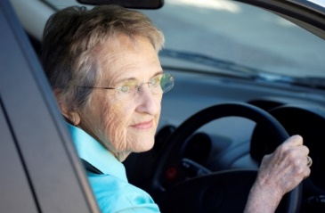
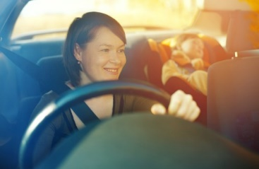
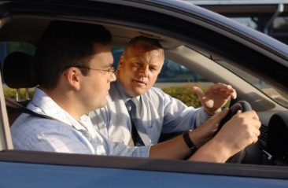
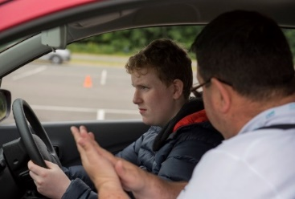
Introducing Modular – Online and On-road Supporting all road users
Who are
Time poor, but know they have needs
Who want
Convenient delivery options
Focused at their level
And only want to
Learn it right; learn it once

Slide 9
Introducing Modular – Online and On-road
Driving with Distractions
Driving on
Rural Roads
Driving on
Urban Roads
Parking
Overtaking
(Car)
Vehicle
Management
Driving on
Motorways
Speed
Management
Vehicle
Familiarisation
Overtaking
(Motorcycle)

Slide 10
3081 Wolverhampton 1978(Sub)

Slide 11
The members I remember
Chairman Bill Goodreds
Secretary Judith Rowley
Treasurer Carol ?
Committee Joe Brooks, Geoff Davis, Tony Robson, Claire,
Others Jeff Bagnell, Mike Robson
Motorcycle section run by Joe from his house
Early members Brian Johnson, John Gardner , Derren Stokes, Alan Foster,

Slide 12
My path
Joined in 1985
1986/7 became chairman
1989 appointed Examiner
Continued as Chair and Newsletter editor
1992 required to stand doen from group
2000 appointed advisor to IAM Council
2004 Joined IAM as paid member of staff

Slide 13
The group
Met at Northcote school
Moved to Goodyear Pavillion
The sports centre
Events
Compton boys club fete, Himley show, WI event 1990
Semphill trophy, Dominic fox challenge
250,000 member event at Lords
Manned National car and bike events at the NEC
National bike rally
Skid Pan sessions at High Ercal

