Slide 1
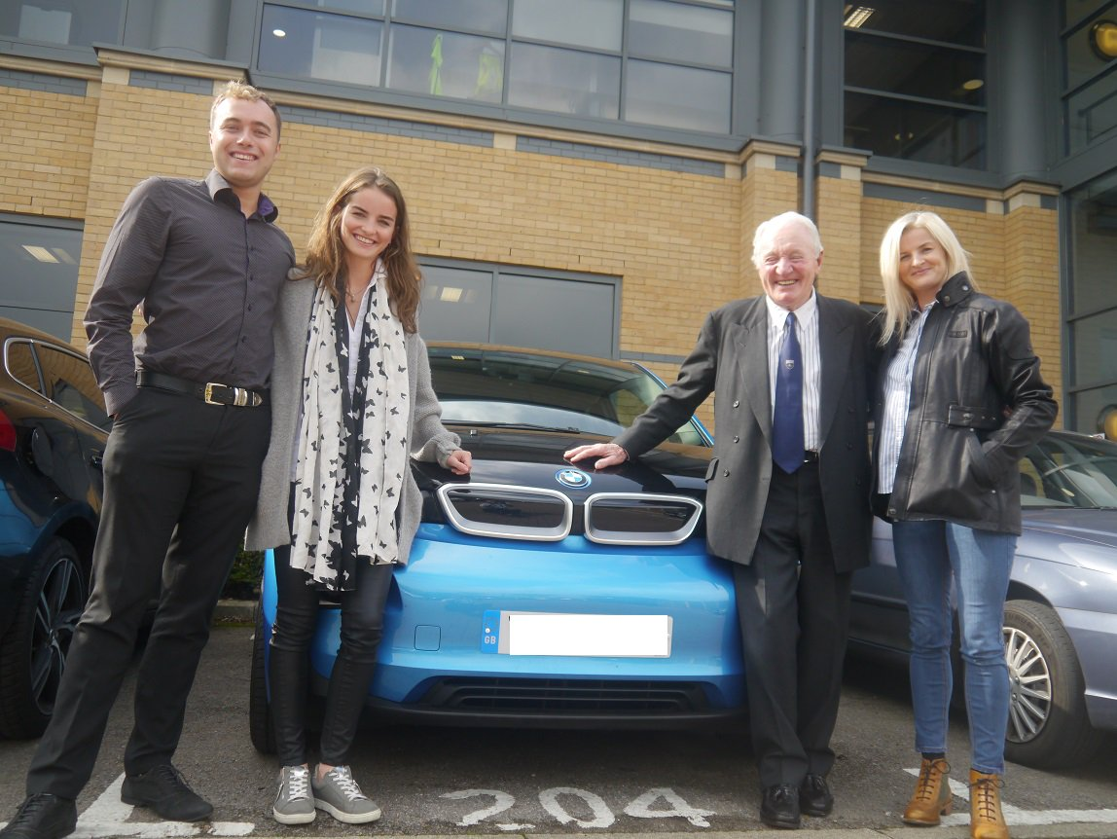
Ambassadors within IAM RoadSmart
IAM RoadSmart

Slide 2
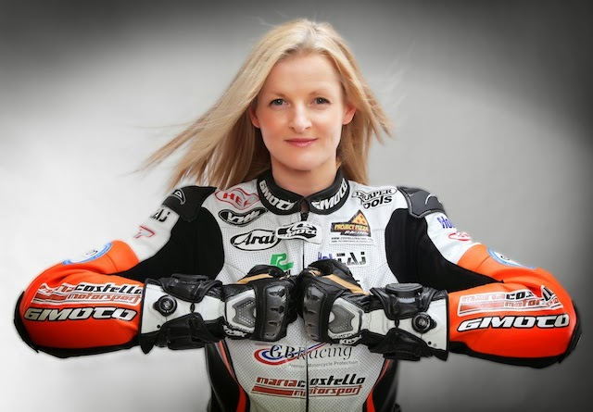
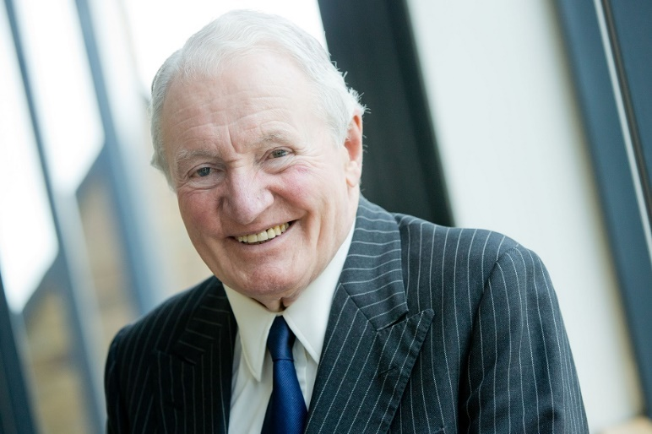
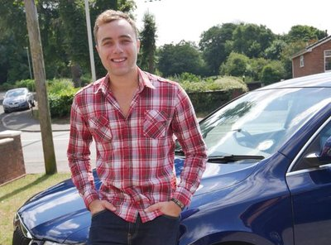
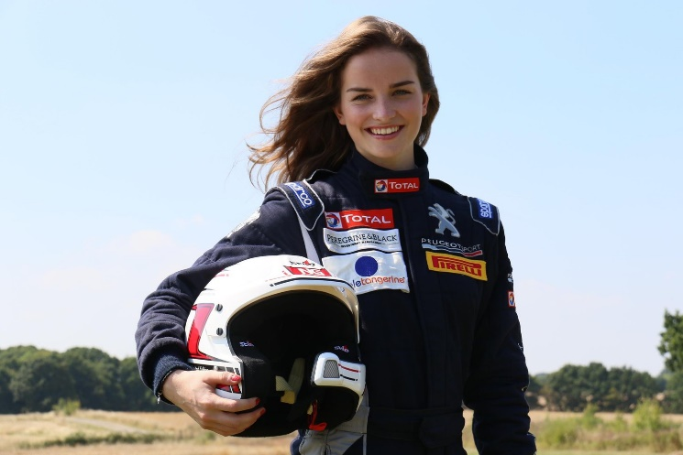
Who are the ambassadors?
Maria Costello MBE
Motorcycle racer
Rider Ambassador
Paddy Hopkirk MBE
Rally driving legend
Mini brand ambassador
Mature Driver Ambassador
David Gallagher
Young Driver Ambassador
Catie Munnings
Rally driver
Peugeot brand ambassador
2016 ladies fia European rally champion
Driver Ambassador

Slide 3
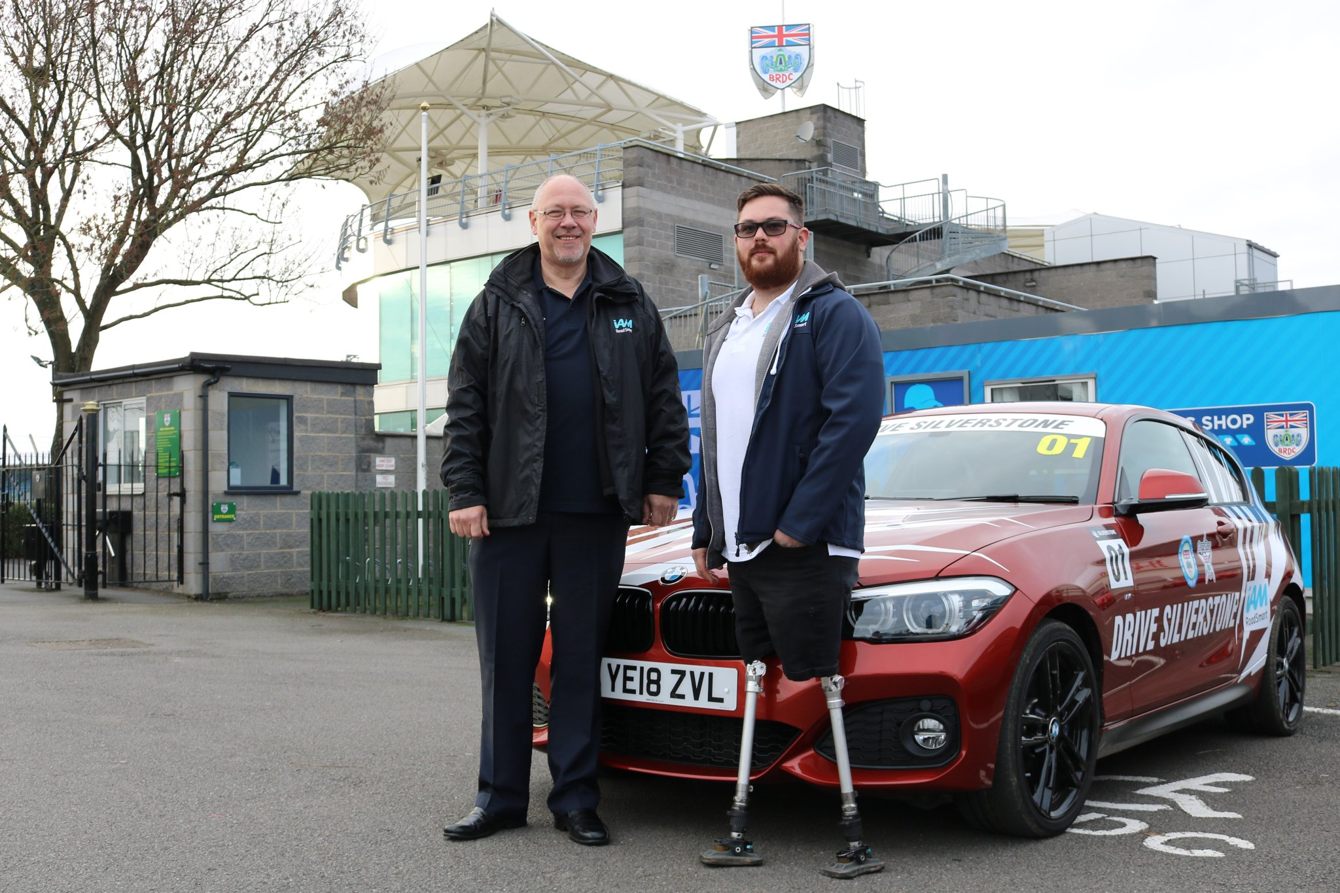
Who are the ambassadors?
Ash Hall
Former Royal Engineers soldier
Military Team Brit racer
Disability Ambassador

Slide 5
Why a younger driver ambassador?
RTC’s are the single biggest killer of under 25’s
Research suggests that- -Learner drivers are the safest drivers on our roads. -Newly qualified 17-25 year olds are the most dangerous? -Young drivers are the fastest age category to learn from their mistakes.
Over time the IAM have become stereotyped with an image that does not appeal to young people. If more young people aren’t attracted to IAM RoadSmart, there will be no future for the charity, as there will be no members.

Slide 6
Younger drivers
Keener eyesight, quicker reactions and a more recent knowledge and understanding of the Highway Code to name just three advantages.
But what the younger driver does lack is the experience gained from years on the road.
It is OUR job to nurture young drivers.
“Young people need models not critics” John Wooden, American basketball player and coach

Slide 7
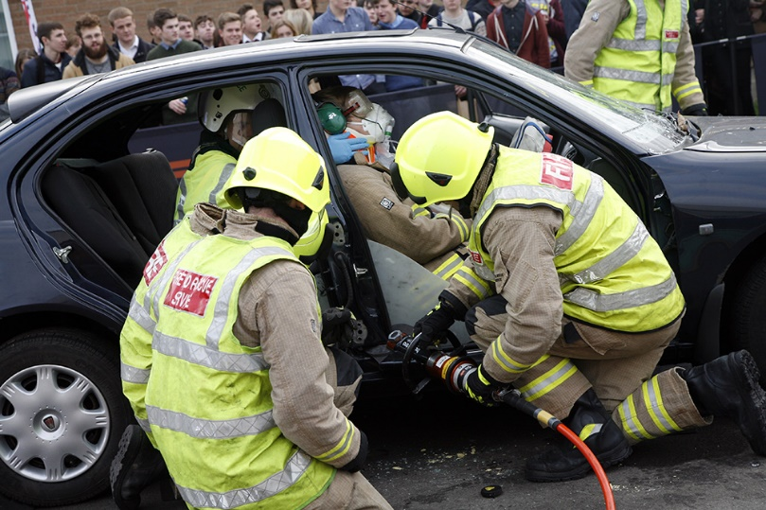
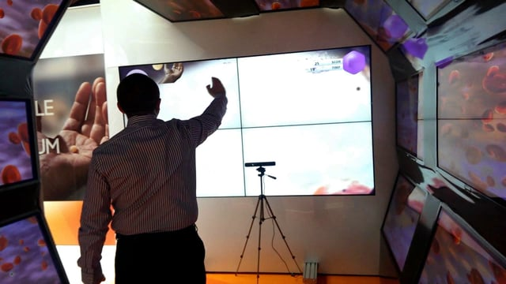
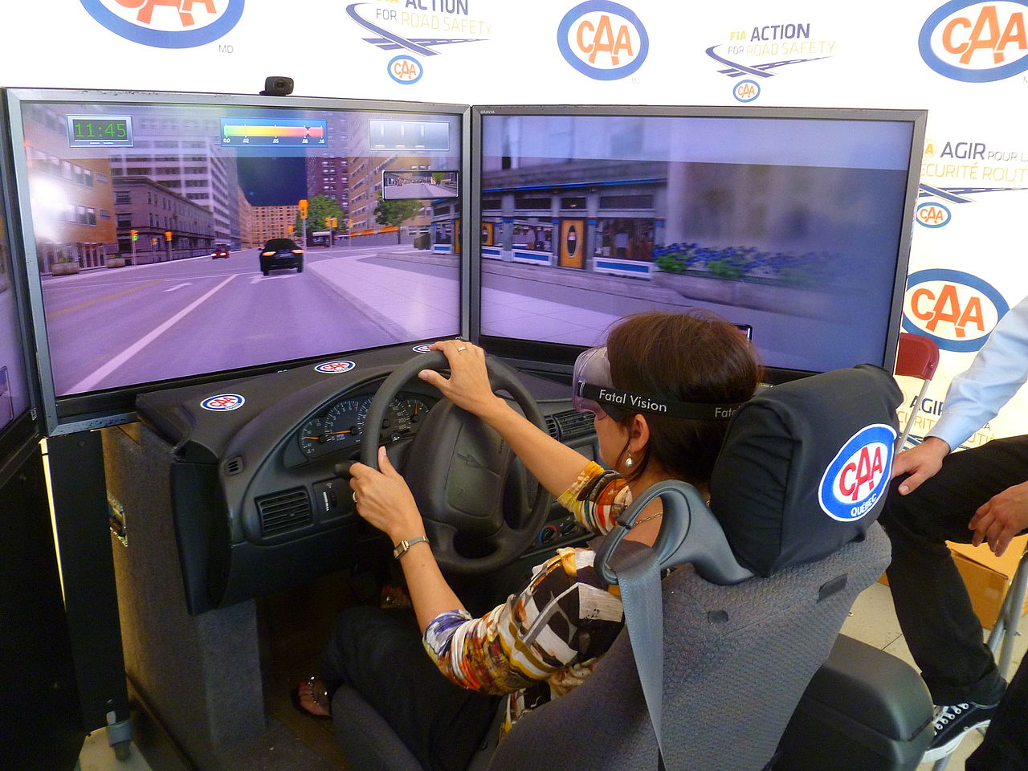
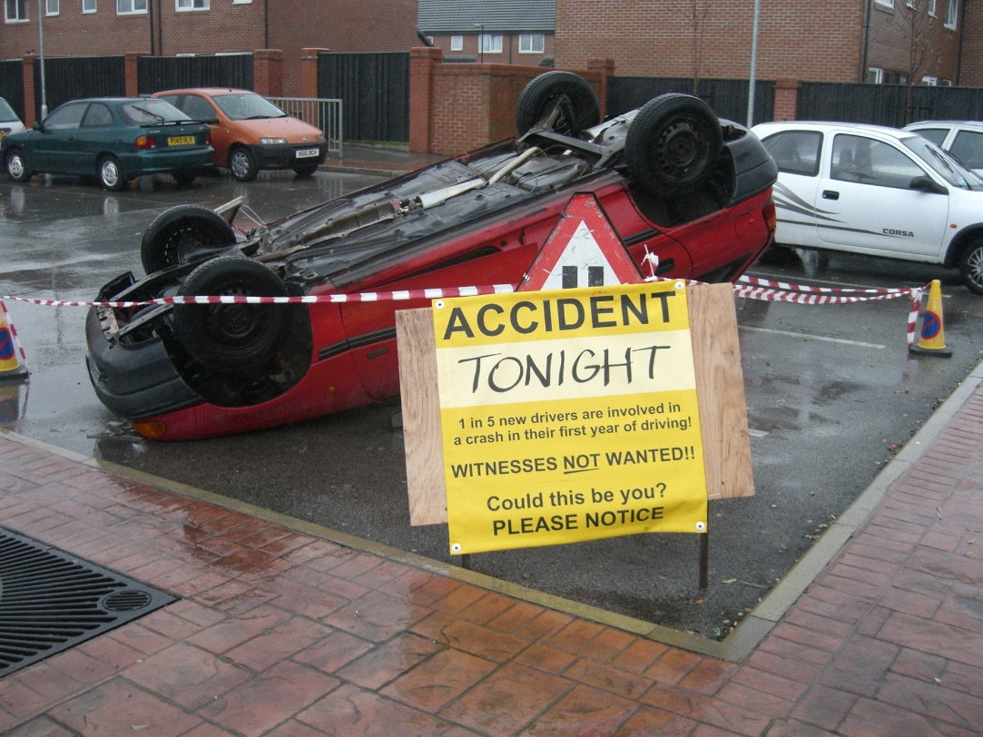
How do we reach younger people to get the best results?
Interactivity

Slide 8
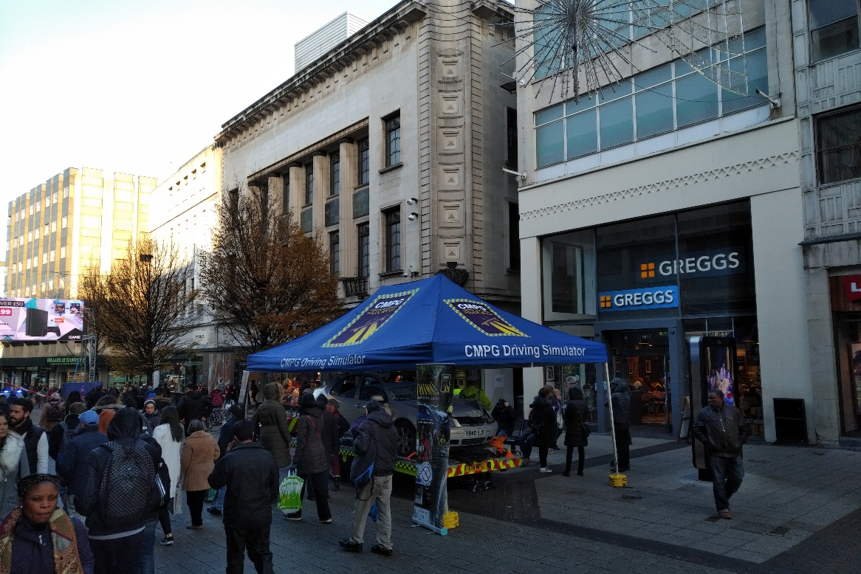
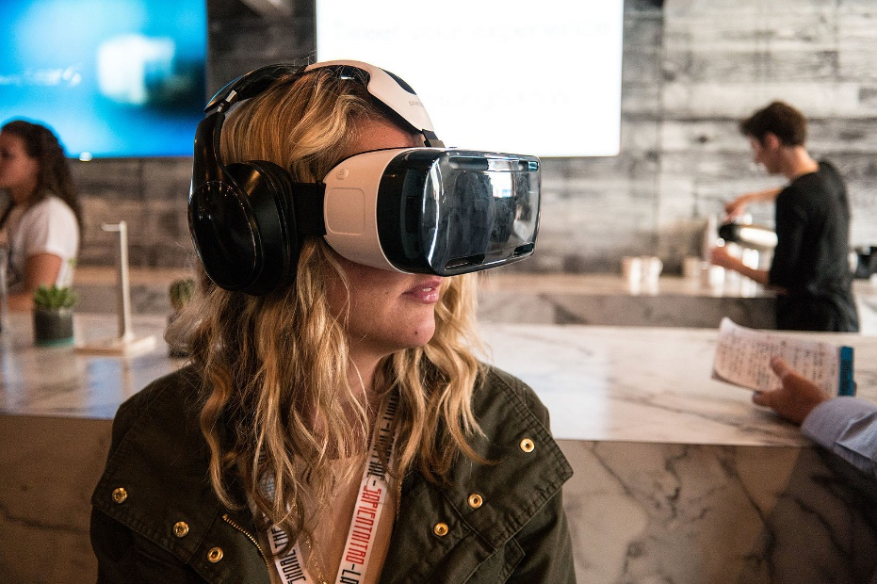
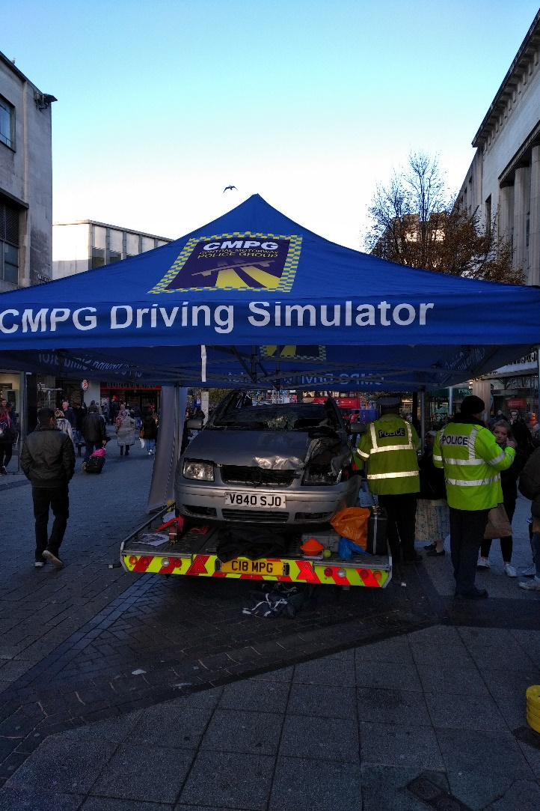
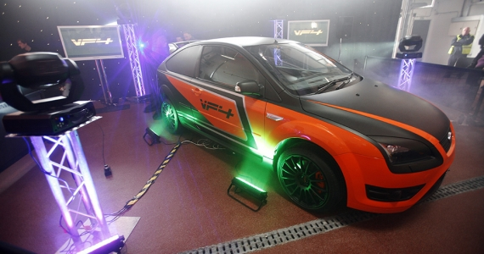
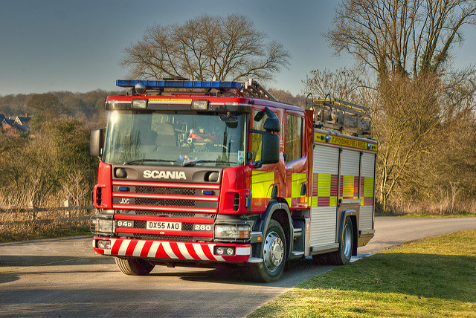
How do we reach younger people to get the best results?
Find those with the resources + funding

Slide 9
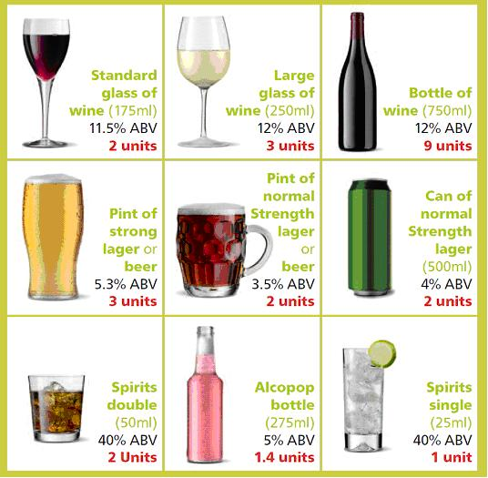
How do we reach younger people to get the best results?
Provoke thought... Out of these servings which is strongest + weakest?

Slide 10
How do we reach younger people to get the best results?
Positivity
“Don’t use your phone at the wheel” “Using your phone will make you more likely to crash”
OR
“a driver using their phone will be more of a risk to YOU because…”
“this is how they are a risk to everyone else, and here is how…”
Develop hazard perception skills, not lecture on rules and laws everybody is already familiar with.
Find a different way to stress important issues whilst remaining positive.

Slide 11
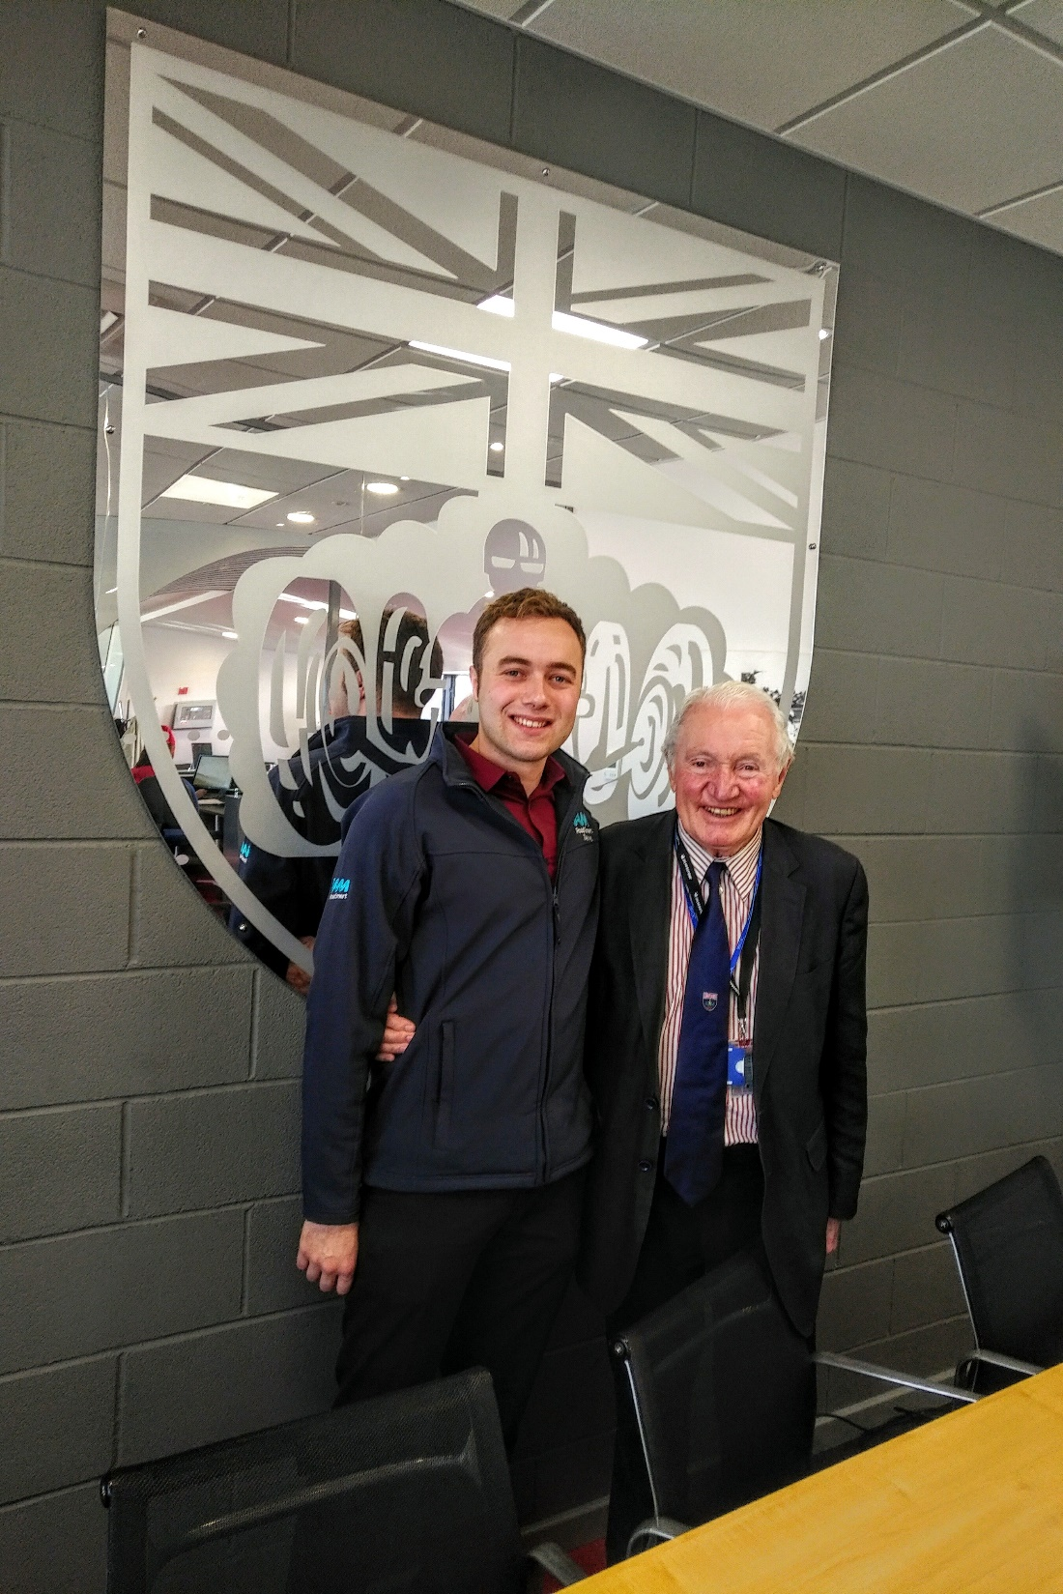
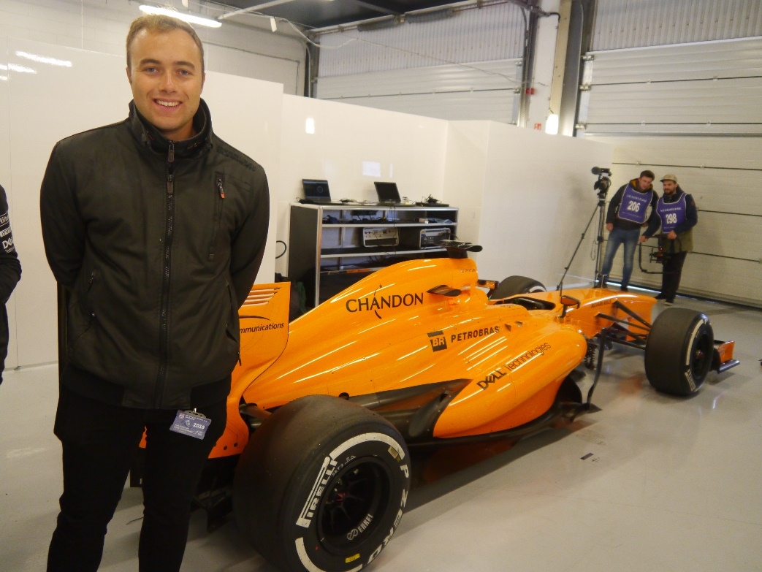
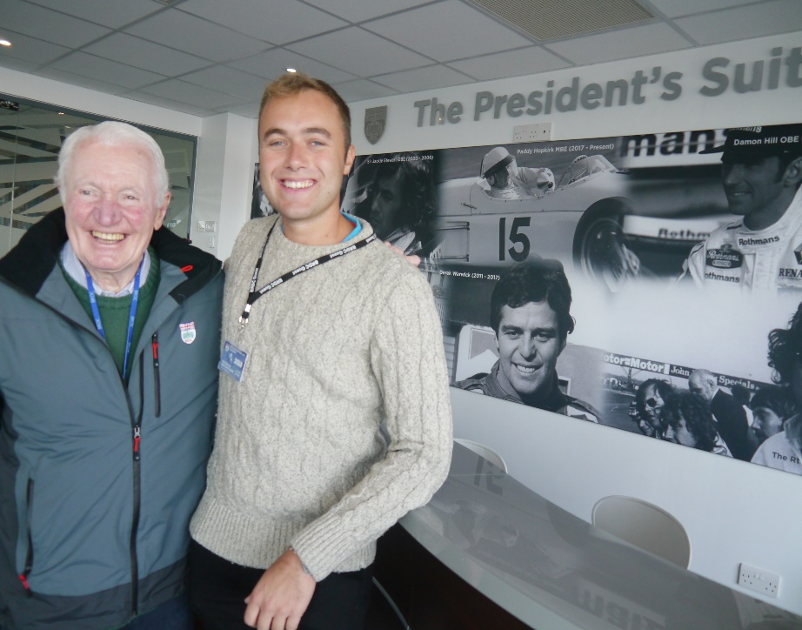
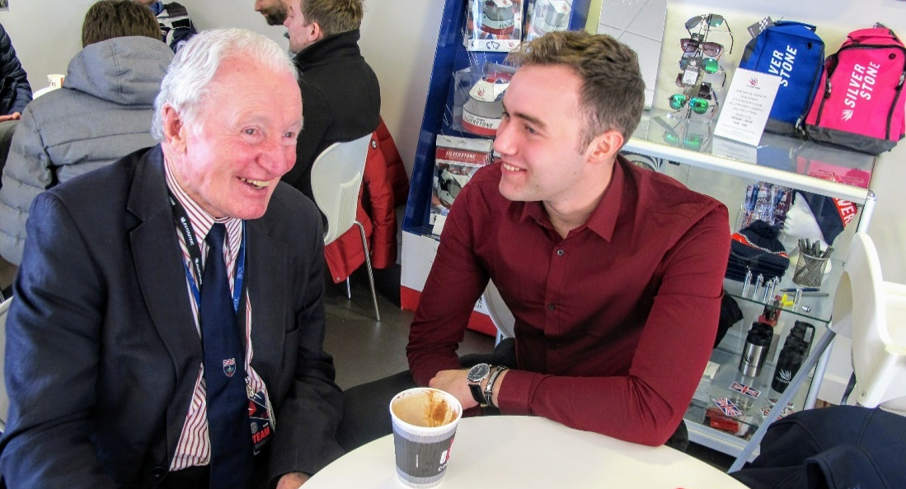
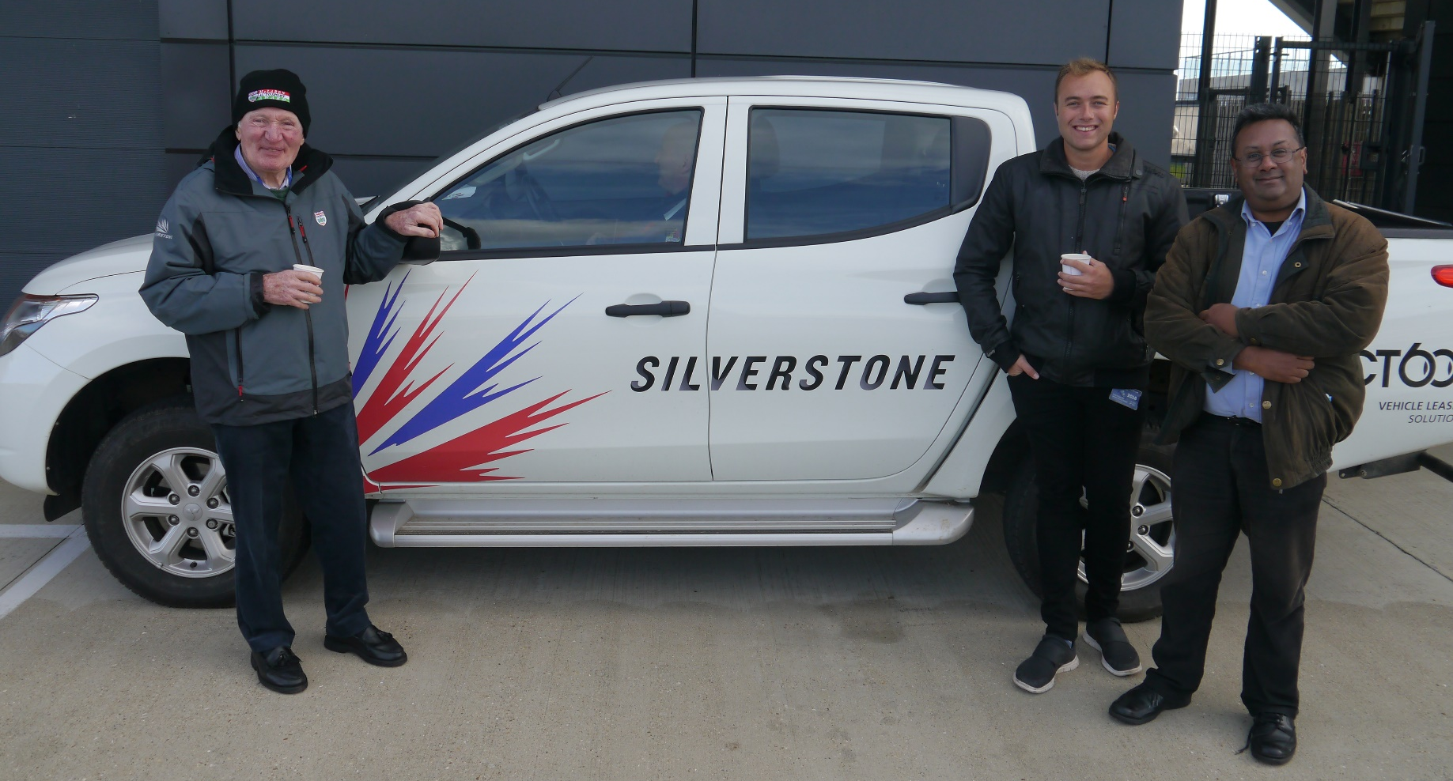

Slide 12
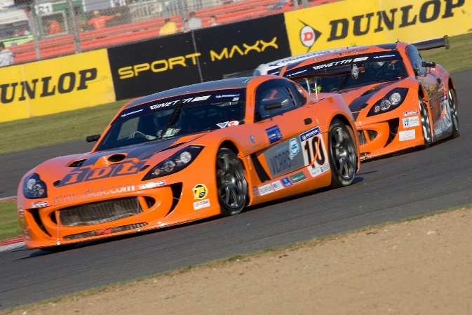
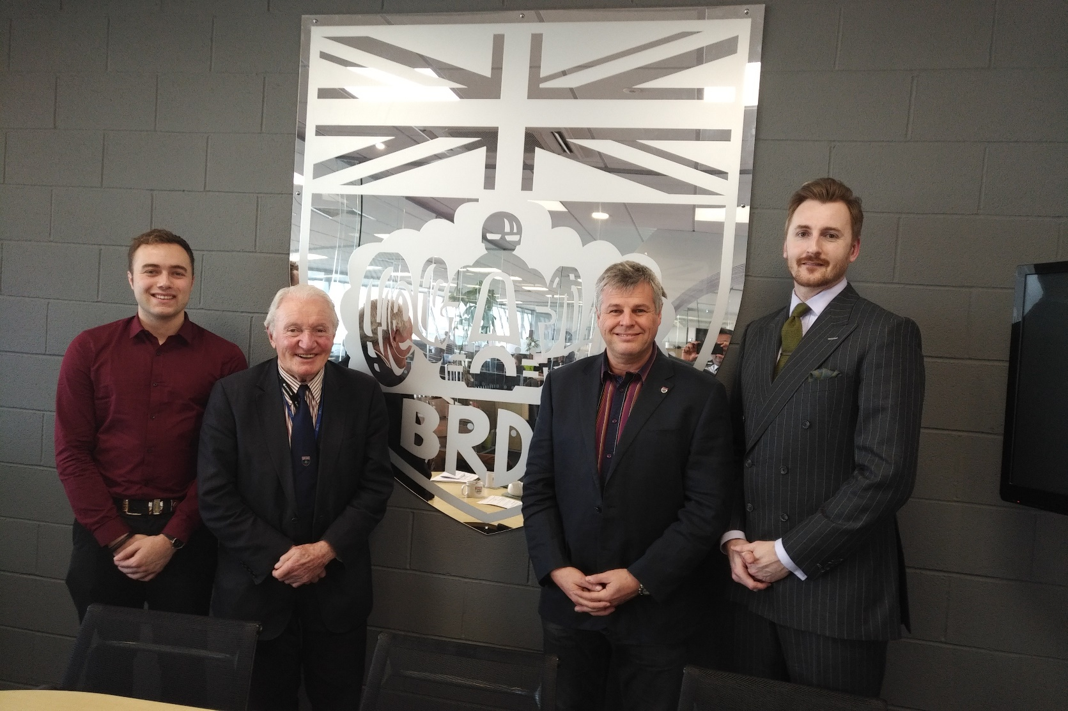
Rising Stars – Silverstone

Slide 13
Rising Stars

Slide 14
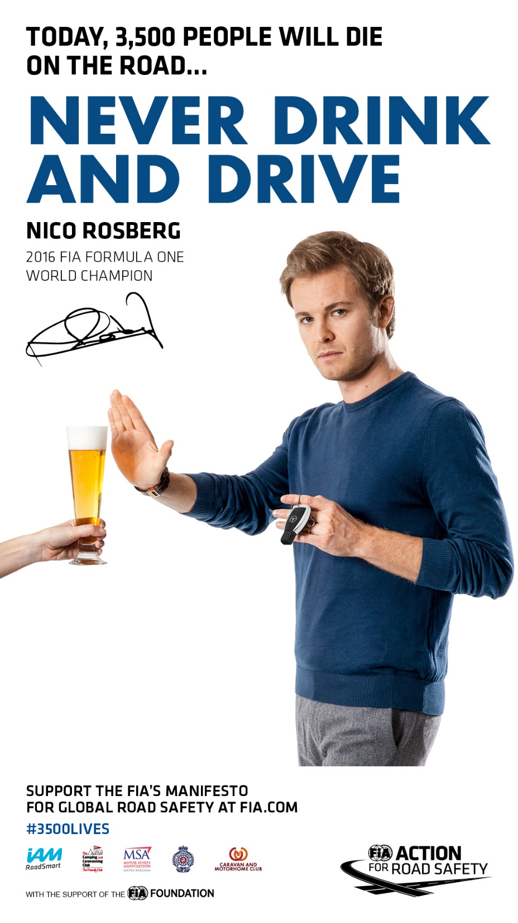
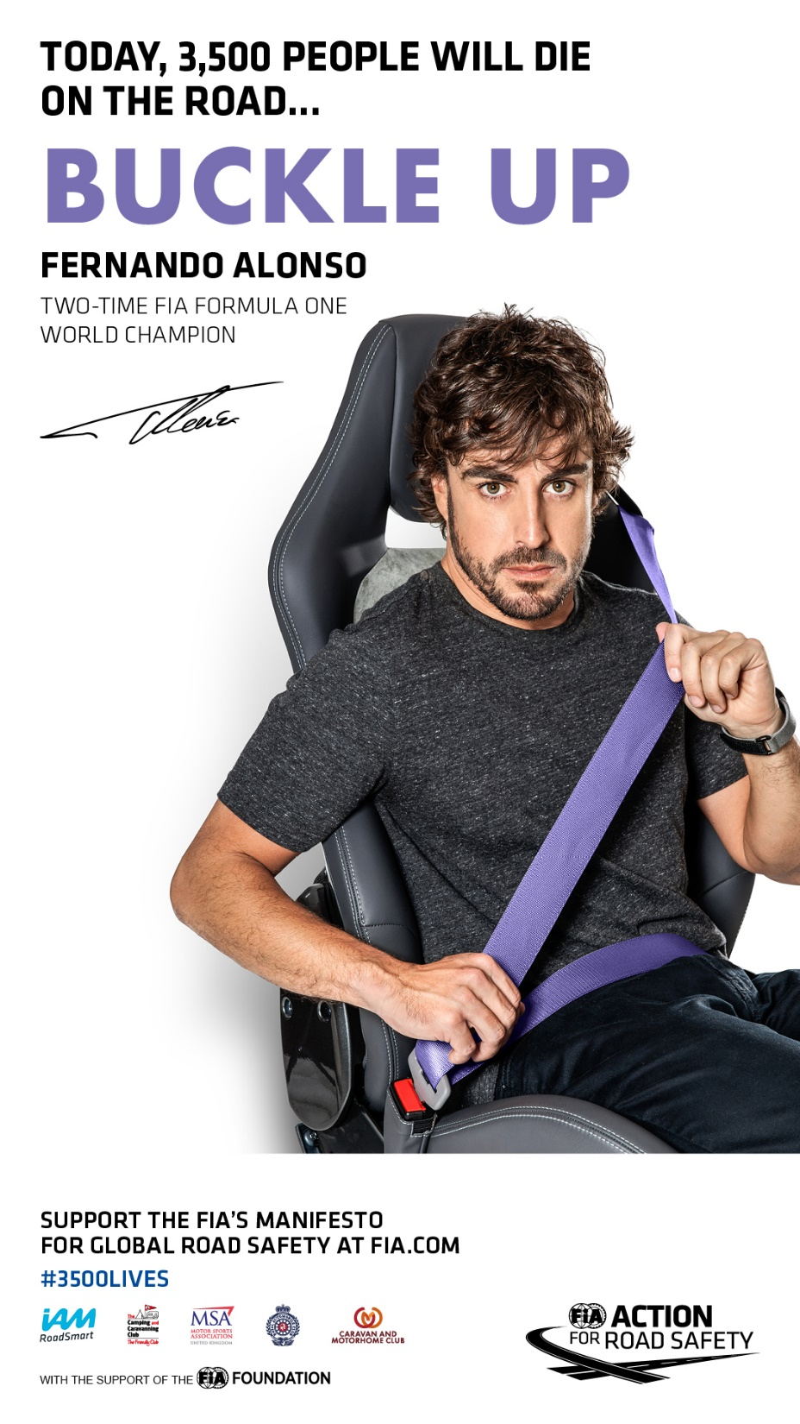

Slide 15
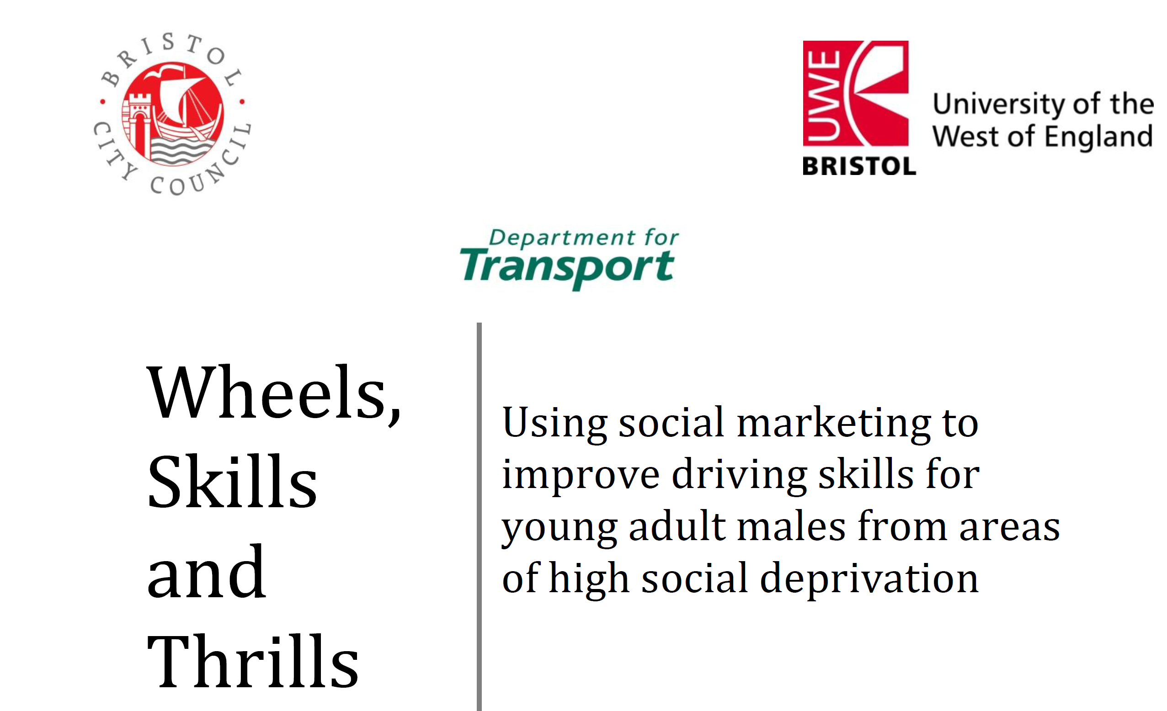
Skill not safety

Slide 16
Asking their opinion

Slide 17
Young Riders

Slide 18
What the IAM was…To what IAM RoadSmart is…
This
To This
460k Advanced Riders and Drivers in 60 yrs
34+ million licence holders
Influence through communications
Online education modules
Reduce KSI Rates
On road modules
Group Sign
off
34+ million license holders
Test
( KSI – Killed or Seriously Injured)
Notes:
Sarah
This Slide Builds – 3 Clicks

Slide 19
IAM RoadSmart
IAM (Charity) formed in 1956
Developed an “Advanced Driving Standard” Based upon the Police Driving Handbook
Added the “Advanced Riding Standard” in 1987
Over 490000 riders and drivers have taken the advanced test
Main product is Advanced Driver and Rider courses which sells circa 6800 per year
Training for Advanced test is through 202 volunteer groups
Currently we have 90,000 members, plus 6890 Associates.

Slide 20
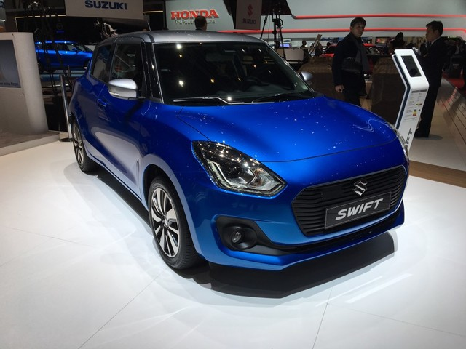
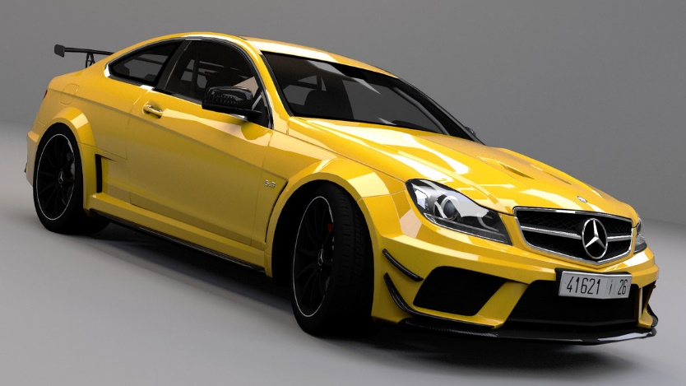
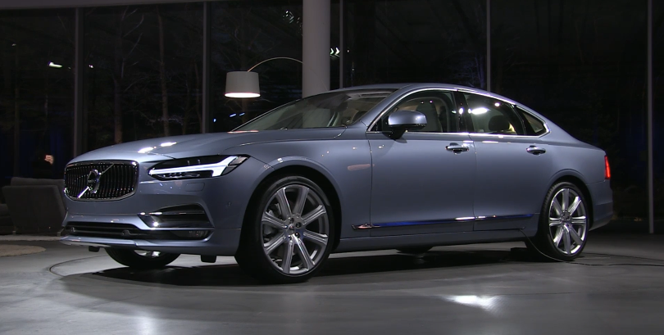
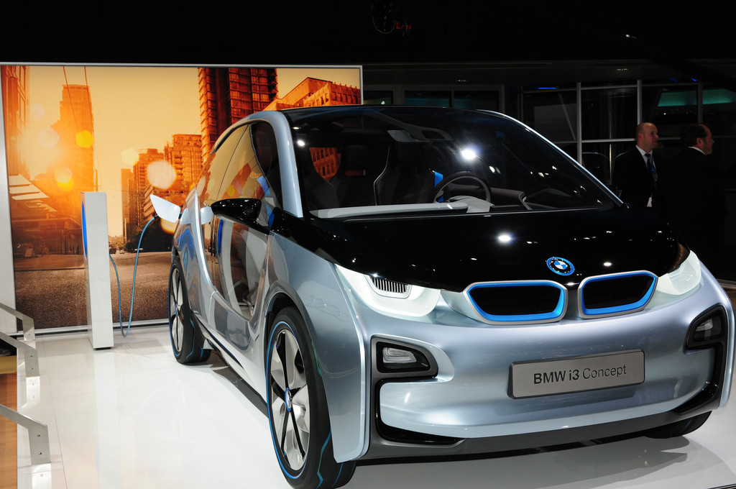
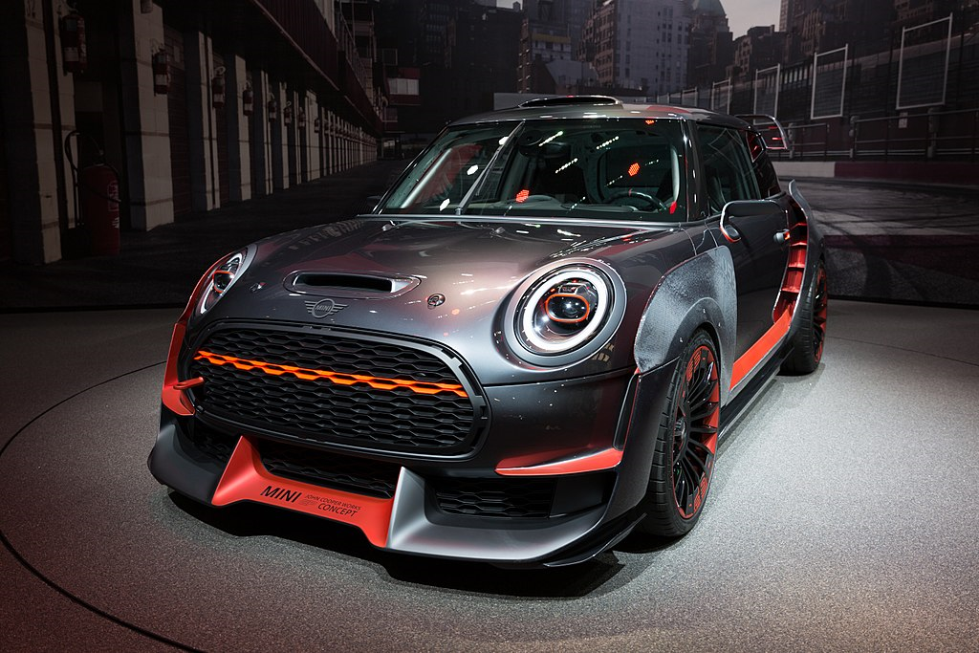
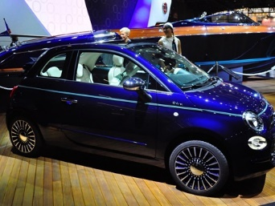
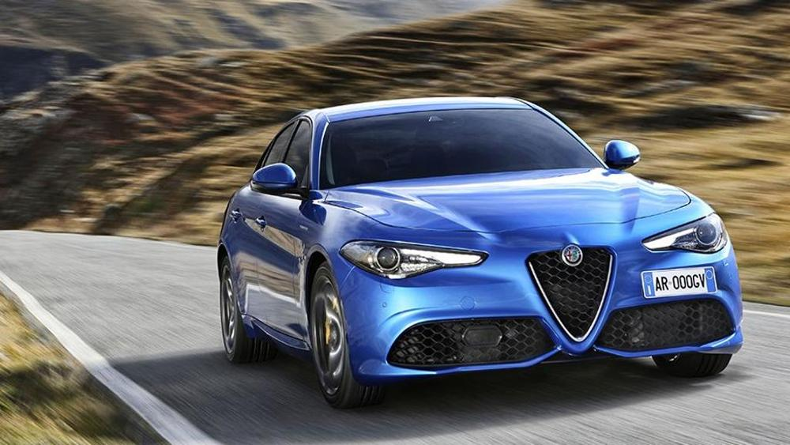
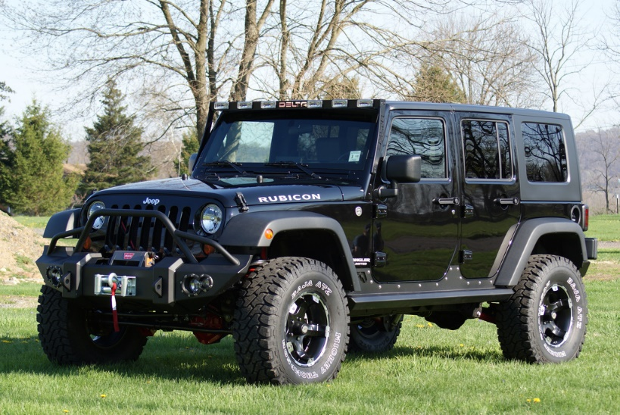
IAM RoadSmart – Benefits
3 member magazines each year
Access to IAM Surety Insurance, which recognises the improved driving and riding, gained by being an Advanced Driver or Rider
Discount on Suzuki, Mercedes, Volvo, Fiat, Alfa Romeo and Jeep cars.

Slide 21
IAM RoadSmart – Benefits
Car Hire and Parking discounts
15% Discount on Biking accessories at Bike Stop
17.5% Discount off tyres at National Tyres and Autocare
10% off UK Weekend breaks with Superbreak.

Slide 23
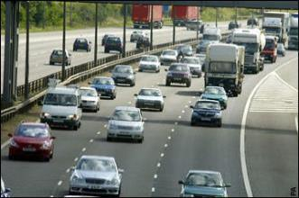
A typical day on our roads…
Sales Rep
41% - Late for meeting
33% - On phone
26% - Thinking of other things
Unlicensed Driver
24% - No driver training
54% - No Insurance
22% - Bad Attitude
New Driver
42% - More traffic than usual
25% - Indecisive
33% - Panic
Distracted Parent
28% - Rushing to work
33% - Kids playing up
39% - Late for School
The Fiddler
17% - Eating food
44% - On Phone
13% - Changing CD
26% - Admiring reflection
Unfit Driver
37% - Poor eyesight
27% - No test taken
36% - Panicking

Slide 24
What's next for IAM RoadSmart? What is available for younger drivers? What is happening within IAM Roadsmart for younger people?

Slide 25
What’s available for young drivers?
Young driver assessment
On road + online modules

Slide 26
Young driver assessment
Online questionnaire, which asks about your lifestyle and driving habits, and assesses your hazard-spotting abilities.
For drivers under 26,who might have a passion for driving and want to advance their skills
Maybe you’re not as confident or experienced as you’d like to be and want to work on particular aspect of your driving
Afterwards, you can have a chat with the examiner and discuss their assessment of your driving skills and how you might improve them; you will also receive a written debrief.
Hopefully the result will be more confidence in your driving and an understanding of how you can continue to improve your skills.

Slide 27
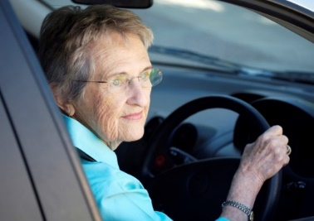
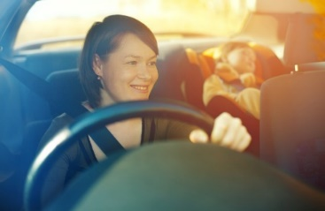
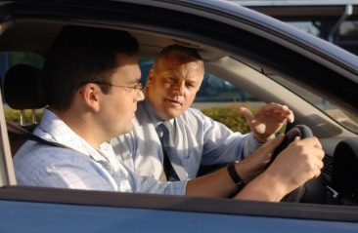
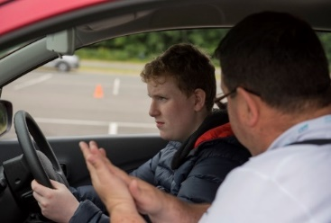
Supporting all road users: Introducing Modular Learning: Online and On-road
Who are
Time poor, but need help in certain areas
Who want
Convenient delivery options
Focused at their level
And only want to
Learn it right; learn it once.

Slide 28
Introducing Modular Learning: Online
Driving with
Distractions
Country Roads
Town Roads
Parking
Overtaking
(Car)
Vehicle
Management
Motorways
Managing Speed
Vehicle
Familiarisation
Overtaking
(Motorcycle)

Slide 29
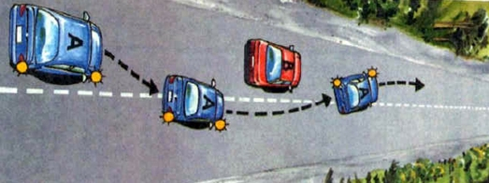
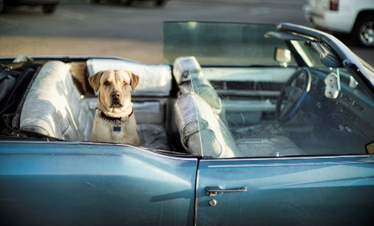
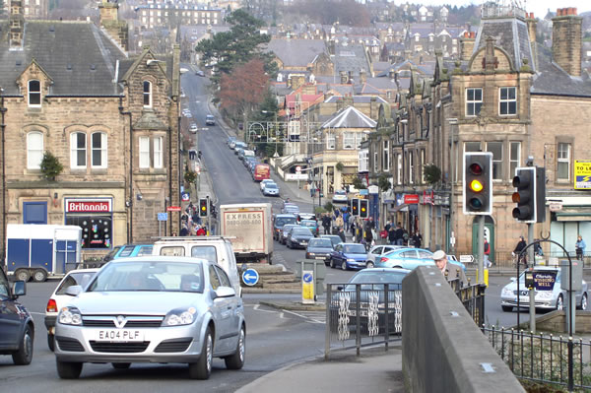
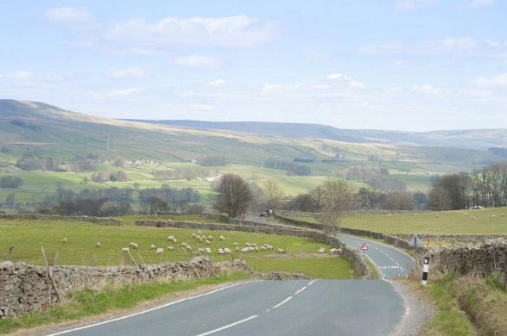
Introducing Modular Learning: Onroad
Managing speed
Managing overtaking
Managing distractions
Driving in towns
Parking & manoeuvring
Driving on country roads
Motorway driving

Slide 30
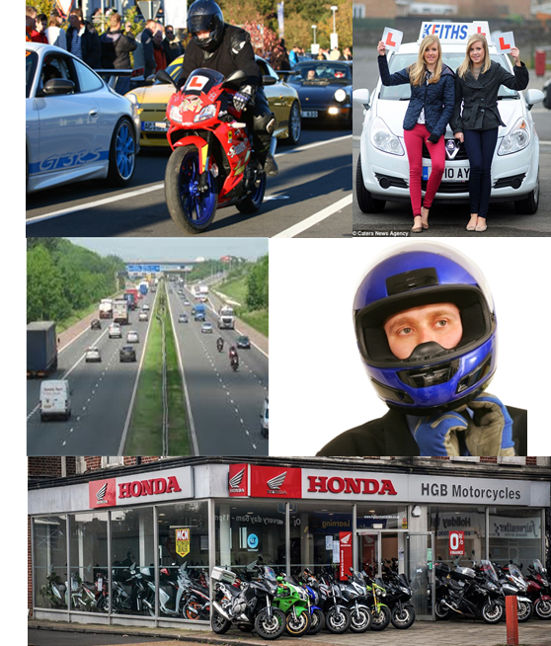
On-road module giveaway
IAM RoadSmart is doing its bit to reduce the numbers of crashes in the UK, by offering free one-to-one expert driving tuition.
On road modules for those lacking in confidence or looking to gain a little experience.
Receive an hours tuition on an area that you feel you want to improve upon.
Charity Giveaway = 1,000 driving module sessions with an ADI nationwide this year
Usually costing £49
See me for a promo code!

Slide 31
The Fatal Four

Slide 32
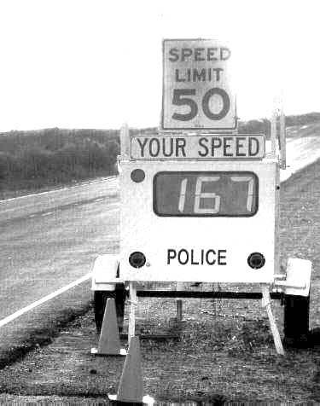
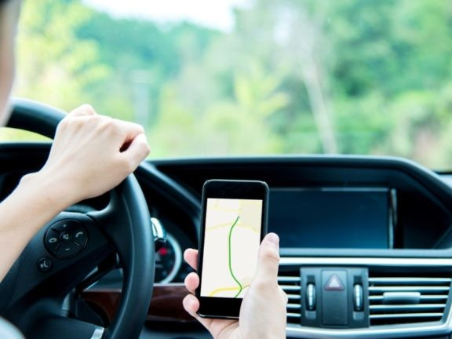
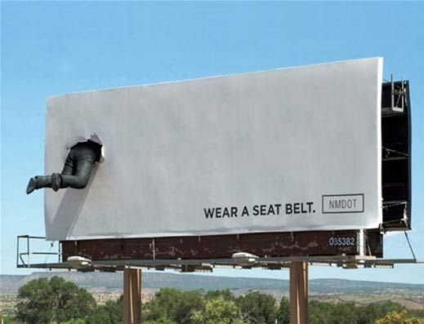
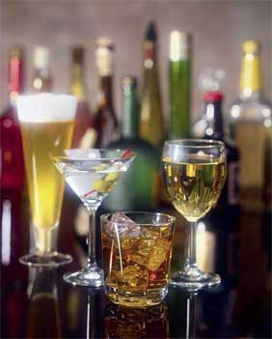
The Fatal Four
Inappropriate Speed
Mobile phones
Drink + Drugs
No Seatbelts

Slide 33
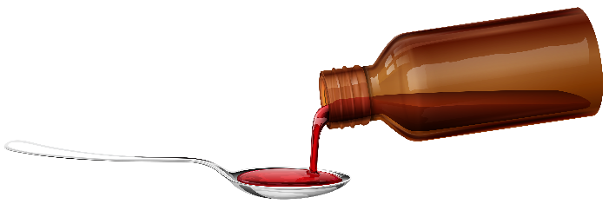
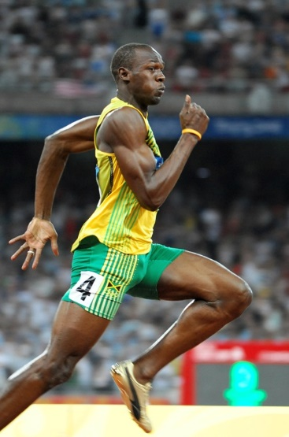
The Fatal Four
Inappropriate Speed
Mobile phones
Drink + Drugs
No Seatbelts
Do you know the strength and size of the drinks that you consume?
Almost every phone has it.
You use it because you don’t want your plane to crash.
Why not your car?
The only one that YOU can fully control yourself.
If you want to add 50% to your survival chances you’ll wear one
How fast can this man run?

Slide 34
Geography…

Slide 35
Geography…

Slide 40
Observations…
Most incidents categorised as ‘slight’
1 fatal incident
Most young driver incidents are ‘slight’
Accident black spot at two major junctions
Large amount of ‘slight’ at the Lawnswood junction onto the main road .Why? People looking elsewhere/ lack of focus? What can we learn from this?
How can we adapt our training to help reduce these accident rates?

Slide 41
Message to take away…
Young drivers are amongst the most criticised road users
They need positive support to help them improve not criticism and assumed risk
Educate Experience Example
The combination of experienced skilful drivers and youthful energy and willing to learn is a great mix
Young driver assessment , On road + online modules are available from IAM to help with this.
Remember IAM’s original 3 aims…
Reduce numbers of those killed or seriously injured
Improve the standard of driving on our roads
Administer the advanced test

Slide 43
Questions ?

